Slide 1
Colorblindness

Slide 2
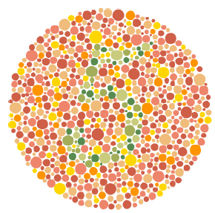
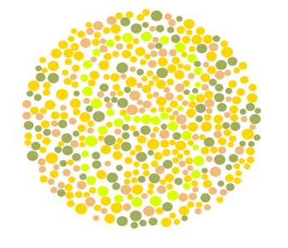
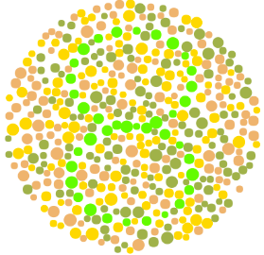
Ishihara Cards
Typically 5% of people cannot spot the hidden numbers in these cards
Usually, these 5% are males!!

Slide 3
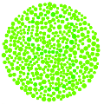
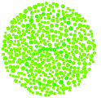
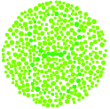
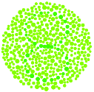
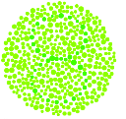
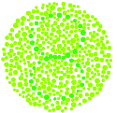
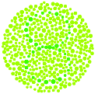
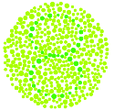
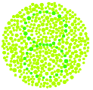
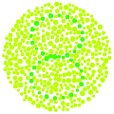
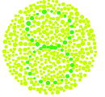
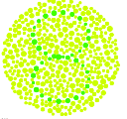
Pinning the Problem Down
The hidden number is in green
The noise around it starts green, but you mix in increasing amounts of red
At what point does the number become recognizable
Trials with many hidden numbers suggest I need more red than others to recognize the hidden number
If I mixed blue instead of red, there wasn’t a difference between me and others

Slide 4
What is Color?
Newton’s experiments indicate there are at least 2 types of yellows
One pure (Y1)
Another obtained by combining red and green (Y2)
Y2 splits when it goes through a prism, Y1 doesn’t
Why does the eye see both as yellow?
Y1
Y2

Slide 5
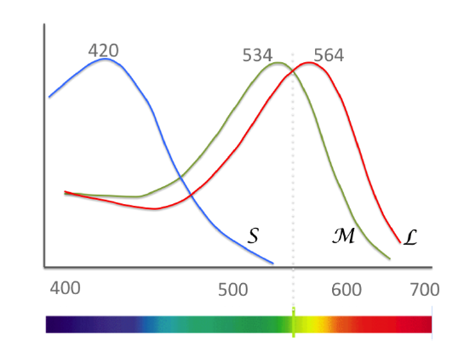
Color Sensors in the Eye
3 sensors together detect many many colors
Red (L) and green (M) sensor responses overlap substantially
Blue (S) is further away
Both red and green sensors respond to pure yellow (Y1)
And of course, both respond to a red-green mixture (Y2)
So both yellow elicit roughly the same response

Slide 6
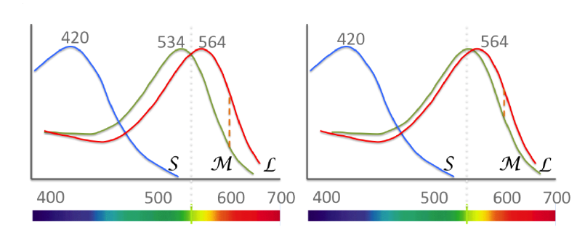
Discriminating Red and Green
What if the red and green hills were to come close?
At an extreme, if they became the same, then red and green will appear the same! Could this be the explanation? What made this happen?

Slide 7
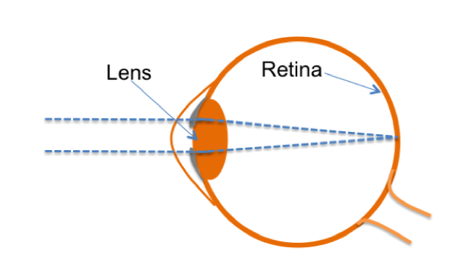
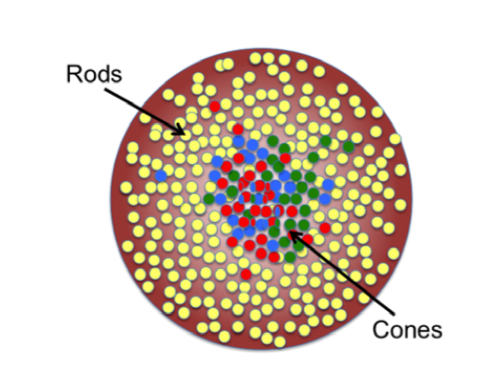
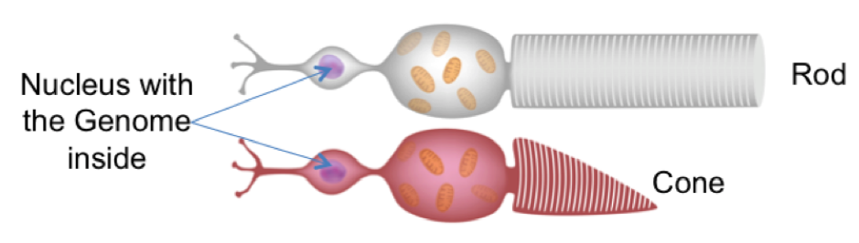
Color Sensing Cells
Color sensors reside in the cone cells in the retina of the eye
Inside each such cell in a copy of the genome

Slide 8
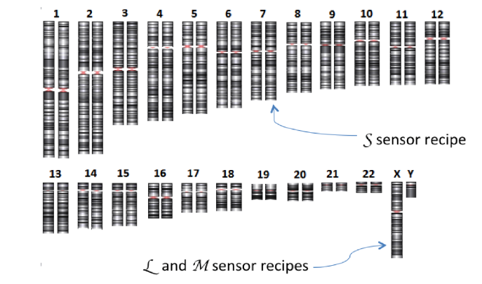
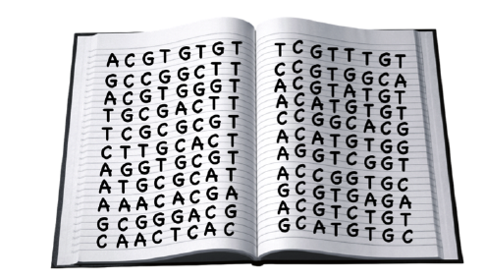
The Genome
23 pairs of books with 6 billion A,C,G,T characters in all
In each pair, one book or chromosome comes from each parent
The last pair X,Y determines gender. Males XY, Females XX
The Green and Red sensor recipes are on X!

Slide 9
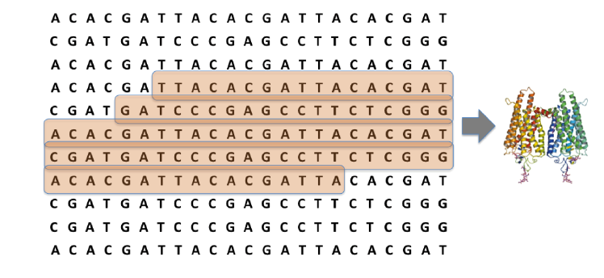
Genes: The Recipe Carriers
Recipes for the creation of color sensor molecules and several other molecules are written in the genome
The chunk of text containing this recipe is called a gene
There are 20,000 genes, each carrying the recipe for one or more proteins

Slide 10
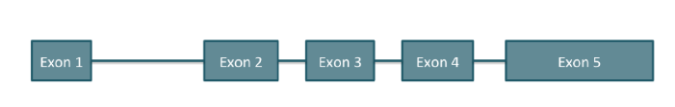
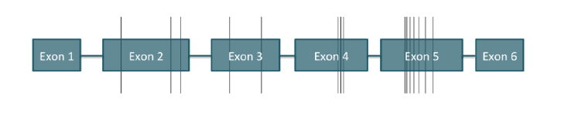
Interrupted Recipes
S or Blue
L and M
Recipes in the genome are not continuous
Exons carry the recipes
Intervening Introns are skipped when the recipe is executed
Green and Red recipes are almost identical, just 15 differences confined to exons 2, 3, 4 and 5

Slide 11

My Recipes and Yours
We differ in just roughly 1 in a 1000 places; so a few million differences in all!
Eg., in exon 3 of the green sensor recipe, I have G where many have an A

Slide 12
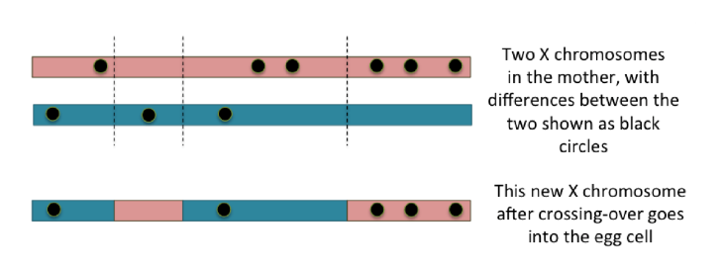
Cooking up New Recipes: Crossing-Over
Which of her two X chromosomes does a mother give to her child?
Neither. She produces a mosaic using a crossing-over procedure.

Slide 13
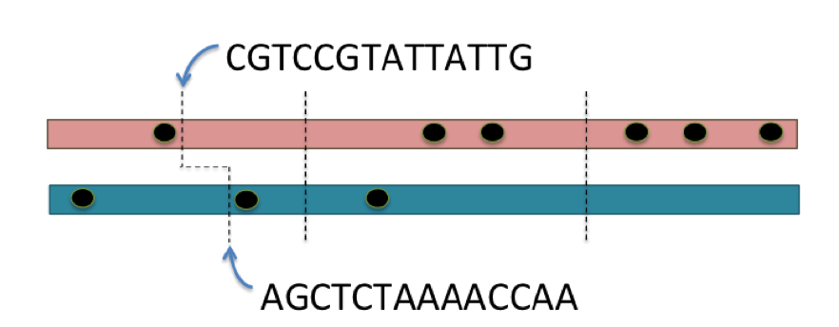
Lopsided Cuts while Crossing-over?
Which of her two X chromosomes does a mother give to her child?
Can crossing-over cut the two X chromosomes in different places, as in the first cut here?
Typically not, because the character sequences at the two places must be very similar, unlike what is shown.

Slide 14
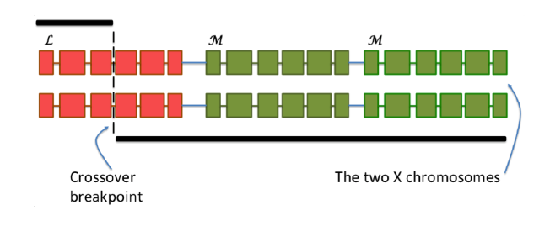
Crossing over for the Red-Green Genes
The red and green genes are right next to each other in the genome
There are actually 2 green genes next to each other, only the first recipe is executed
Crossing-over can create new recipes as shown

Slide 15
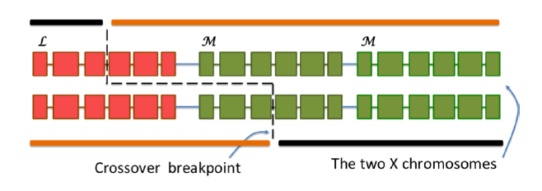
Lopsides Cuts: Red and Green Genes?
These cuts can actually happen because the red and green genes have almost identical character sequences
And this can lead to the creation of some new hybrid red-green recipes.

Slide 16
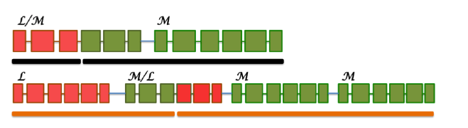
Hybrid Red-Green Recipes
There are just two genes in the first case, four in the second
In both cases, note the red-green hybrid gene

Slide 17
Hybrid Red-Green Recipes
There are just two genes in the first case, four in the second
In both cases, note the red-green hybrid gene
This could bring the two sensor peaks closer, as we say earlier!

Slide 18

A Peek at My Recipes: NGS
ACTCTG
CGTGG
CTCTTC
CCCTGAA
ACTCTG
CGTGG
CTCTTC
CCCTGAA
CACTGCA
CTGGAA
TGATCAAA
ACACACG
Start with many cells, so many copies of the genome
Tear each copy randomly into tiny shreds (or reads) of about 100 characters each
Tens of millions to a billion shreds! We know the sequence of each.
We have to now assemble this jigsaw back! Not easy!

Slide 19
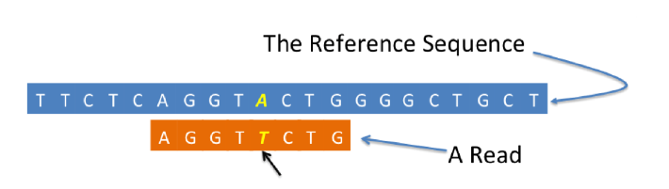
Solving the Jigsaw Puzzle
The Reference Sequence to the rescue: the genome sequence of 5 healthy individuals
Any two genomes differ roughly in 1 in 1000 characters, so very similar to each other
Search for each read in the reference sequence, with some allowance for error: Read Alignment

Slide 20
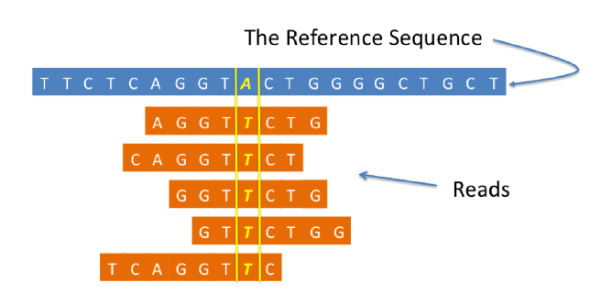
Variations in Recipes
Once all the reads are placed at their rightful places along the reference sequence..
Differences between the reference and the genome being sequenced stand out
These are called variants

Slide 21
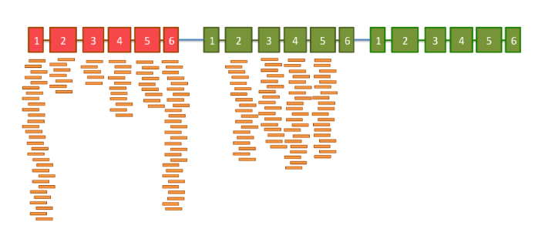
Reads Aligned to the Red and Green Genes
No reads on the second green; all these reads have gone to the first green, because the sequences are identical
No reads on exons 1 and 6 of the green gene; all these reads have gone to the red gene, because the sequences are identical
Exons 2, 3, 4 and 5 are different between red and green, so reads can be assigned unambigously

Slide 22
Fraction on Red for Exons 2,3,4,5
50%,50%,50%,50%
L
M/L
M
1
2
3
4
5
6
1
2
3
4
5
6
1
2
3
4
5
6
L/M
M
100%,100%,0%,0%
1
2
3
4
5
6
1
2
3
4
5
6
33%,33%,100%,100%
L
M/L
M
M
1
2
3
4
5
6
1
2
3
4
5
6
1
2
3
4
5
6
1
2
3
4
5
6
33%,33%,33%,100%
L
M/L
M
M
1
2
3
4
5
6
1
2
3
4
5
6
1
2
3
4
5
6
1
2
3
4
5
6
Which of these possibilities matches the data? And with what confidence?

Slide 23
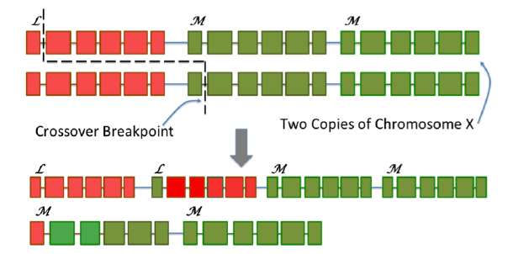
Could Be Worse: Only 2 Colors!

Slide 24
Thank you

